Slide 1
MFL Games
These are all games suggested by members of the TES forum in a thread started by ‘JennyD’
http://community.tes.co.uk/forums/t/129376.aspx
And then added to by members of the Talkabout ning group https://talkaboutprimarymfl.wikispaces.com/
Variations on games can be found in the notes pages underneath each slide

Slide 2

la pomme empoisonnée
materials needed: small card 'apples' in a variety of colours
to practise: colours, position of adj.(in this case, colour) coming after noun
Show the apples to the pupils, practise the colours 'c'est la pomme rouge', etc.
Volunteer goes to other side of classroom and turns back to class.
We decide on an apple to be 'poisoned' and pretend to sprinkle it on.
Volunteer comes back and pretends to munch his way on the apples, taking each one in turn and saying what it is: 'c'est la pomme verte..jaune...bleue...etc. etc.
When he gets to the poisoned one, the class shriek out 'tu es mort', They get to then do practice convulsions! Winner is the person who manages to collect the most safe apples.
JennyD

Slide 3

21s
All pupils stand and one by one have to spell out a piece of vocabulary, but nobody knows who is going to say the next letter.
If two (or more) people say it at the same time then they are out! Keep going till you have just two people left.
Lingo lass

Slide 4

Gap fill around the room
Put the words for a gap fill tasks on pieces of paper stuck around the room.
Get the students to find them and then figure out where they go.
Lingo lass

Slide 5

Kim’s game/the OHP game
Turn your OHP on, put pieces of realia on the base eg. pen, ruler, pencil, pencil case, sharpener.
Point to the objects on the board, and get pupils to repeat the vocab.
Then turn OHP off, take an object away
"Was fehlt?" (what's missing?) and pupils have to go through vocab.
They love it....espesh if you split them into teams - boys ALWAYS win for some reason.......lalalalalala
Colvie

Slide 6
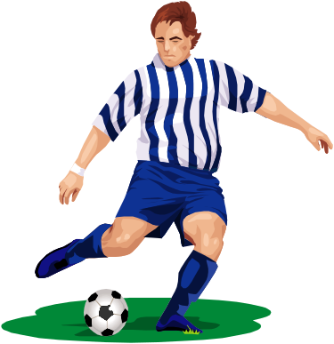
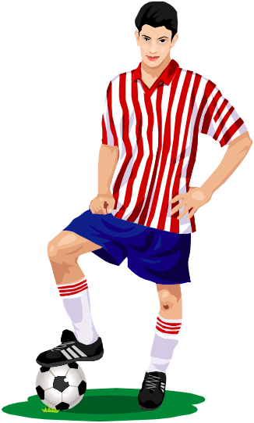
Penalty Shootout
Available through atantot extra http://www.atantot.co.uk/
Or free from
http://www.espanol-extra.co.uk/
Or make your own from http://www.contentgenerator.net/
Smoothnewt, whapbapboogy, goneunderground et al.

Slide 7
Bingo
12 | 3 | 4 | 27 | 39
34 | 18 | 56 | 32 | 4
7 | 36 | 18 | 67 | 20
54 | 14 | 9 | 11 | 5
mpc
Notes:
Could be any topic words or pictures

Slide 8

'Psychic Powers'
Students are given a finite list of words/phrases (1-10, for example) and have to guess the number in my head.
This activity encourages boys to listen to others speaking too so that they don't repeat a number, blow their chances of winning!
Lingo lass

Slide 9

Make your own
http://www.classtools.net/

Slide 10

Collective memory
I make a rough drawing on a given topic.
Each group sends up a representative one at a time, looks at my original for 10 secs or so and then has to report back to their team.
I award extra points for writing the Spanish words too.

Slide 11

The Fred Game
Two kids are sent out.
One kid in class is Fred.
The two kids who were sent out come back in and ask questions until they find Fred, e.g. Wie heißt du? Ich heiße Fred.
You can play it with other vocab as well...and it gets the kids talking.
Ghandi
Notes:
Just had to say I tried out the FRED game with my bottom set year 9's to practise illness vocab; pupil had to ask "Qu'est-ce qu'il y a?" until he found the person with "j'ai mal a la tete". They loved it and even managed to remember some of the vocab for a change so thanks for the idea. Keep them coming!

Slide 12
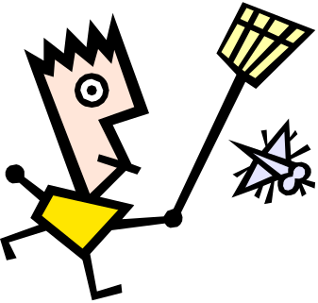
'touch the picture' / slap!
Items of vocabulary or pictures to represent vocab(without translations)are up on the board. I use a projector screen or you can do this with an IWB as long as you lock all the items in place.
I ask for 2 volunteers and the come to the front and they are each given a different coloured feather duster.(Kids like it and they are soft so they don't damage the board! You could also use fly-swatters.)
I say 3 phrases/words and kids have to touch the correct item as fast as they can.
The game is out of 3 and the winner gets to have another go.
To reinforce the spoken element, after a few examples I ask for another student to be the teacher and say the 3 phrases instead of me.
Cmw77, lingo lass, flamby, et al

Slide 13

Heads down thumbs up
Choose a few pupils to stand at the front.
Give them a 'new name' using the vocab you have been teaching eg. Monsieur pomme, madame banane etc.
The rest of the class put their heads on the table (with eyes firmly shut!) and put their thumbs up on the table.
Pupils at front then go to one pupil each and put their thumbs down. Go back to front.
Those chosen have to stand up and guess (in French, or other target language!) who they think picked them.
Those who guess correctly get to take a position at the front, and so it goes on.
Sammilein, JennyD, ladywardy, et al
Notes:
Heads down thumbs up.. 2 boys 2 girls stand at front.
Class close eyes and make their hands into a fist and put their thumbs up..
4 pupils at front go around and whisper one French word or phrase into 1 person's ear. (I usually tell them to use vocab from that lesson) when you tell them to the 4 pupils will then stand and guess who the person was and what the word was.. I get them to disguise their voices.. If they guess both things correctly they then swap places.

Slide 14

telepathy
10 words on the board - key vocab.
Kids all have plastic mini-whiteboards and pens - me too!
Kids all stand up.
I write (in secret) one of the key words from the board.
They all write 1 down too
They reveal their boards to me - I wait till everyone has revealed their board - then I flip mine over for them all to see.
If they have matched with me, they can sit down. If not, they rub off their word and we start again (after I have removed the word we just used from the list of 10).
In subsequent rounds, those sitting can continue to write down a word "just to see if they really can read my mind". Stupid game, but they like it. And it gives them lots of practice writing the key words.
Petite Joueuse
Notes:
Petite Joueuse, I used your "telepathy" game, too!
I was a bit worried that my class wouldn't stay focused for long enough to play it with elmination and a final winner, so I just divided the class into two and for each one I did, I gave points to both sides. (e.g. 3 points if three students had guessed correctly.) I used it to practise new iregular verb. They had to guess which part I had written.
The game was a big success - I teach more than one class at the same level, so I have a built-in "Success of Activity" monitor. Sure enough, the afternoon students come in asking whether they were going to be doing mind-reading, too!
And, more importantly, perhaps, they seem to be remembering the verb parts. I had an observation during one lesson, so I was doubly grateful for your idea. Many thanks!

Slide 15




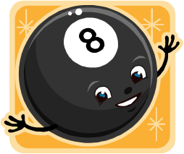


random numbers
-3
Write some random numbers (including negatives) on the board and stick flashcards over them.
Students are in teams, they tell you a phrase, you take off the flashcard and that is the number of points they get.
flamby

Slide 16
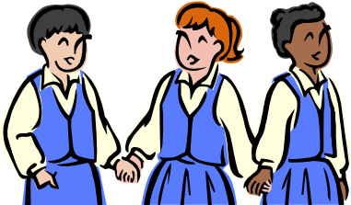
Chorusing games
once you've chorused through a few times, play a "simon says" type game.
If you point to something and say the right word, they chorus, if you say the wrong word, they shouldn't.
If they say it at the wrong time, you get a point, if they don't, they get a point.
When they get more confident, you can swap a student in to pronounce the words. They love beating the teacher at this (first to five points, for example).
flamby

Slide 17

Pictionary variations
With mini WB - I say a word in the target languages
They have to draw it as quickly as possible.
Points for being first/last/most artistic!
I've also done this with reflexive verbs - e.g. I say "me despierto" and they have to write "I" and draw themselves getting out of bed. Bizarre how they find it fun, but they do!
flamby

Slide 18
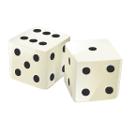
Smartboard dice
If you have a smartboard, you can use the flash dice from the gallery to do loads of games where they roll the dice and have to make sentences
- e.g. six times, six daily routine words, they roll two dice on the board and have to make sentences for points.
flamby

Slide 19
connect-4 dates!
8
13
29
15
23
 | janvier | février | août | avril | mai
Draw a 6x6 grid and write numbers along one side and months down the other.
To get a square they have to give the correct date (can be extended to saying my birthday is...).
2 teams trying to get 4 while blocking the other is great!
Can also be used to revise numbers and letters.
freddyrocks
Notes:
Could do this with any combination of object and adjective too – eg animals and colours…

Slide 20

Loads of free online games
http://atantot-extra.co.uk

Slide 21


Jeopardy
I play this on the ohp but there is a computerised version available on the internet somewhere.
Pick four sub-topic headings and make 5 questions for each, ranging from 100 to 500 euros. (100 will be dead easy like "j'ai un hamster, 500 will be super hard).
Team with the most money at the end wins.
All you have to do is write 20 questions but my lot love it for some reason. It is very good for pre-test revision lessons
Kat25

Slide 22

refreshing questions
I carry a small, soft juggling ball.
I ask someone a question and if they answer correctly, I throw the ball to them.
They then choose someone to ask and pass the ball on if the answer is correct...etc.
Don't know why but year 7 seem to love this.
freddyrocks

Slide 23
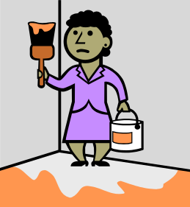
'les quatre coins'
Stick flashcards around the room to represent the vocab you have been covering.
Teacher turns back to class and ideally, has some French music playing.
When the music stops (or when you call 'arretez!'), the kids have to go and stand by one of the flashcards.
Winners are the pupils/pupil standing by the one you have called out.
Lunar67, JennyD, Gandhi, ladywardy, et al.

Slide 24
Variation – corners
We used to play a game like that in maths. Four people, one in each corner and then we had to answer questions. If we answered one correctly we were allowed to move on to the next corner. The first person to make it round the room wins. Suppose you can also play that with Vocabulary or even grammatical questions!
Lunar67, JennyD, Gandhi, ladywardy et al.
Notes:
Corners.. SEN kids love this one!!!
2 boys and 2 girls to start..
4 pupils stand in a square if not enough space (or in each corner of the room if more space)
teacher usually starts by asking a question.. eg, what's a dog? pupils in square need to put their hands up.. whoever gets hand up correctly gets chance to answer. If correct they then move clockwise and the pupil there gets knocked out.. You can get the audience to ask questions- they love that. If it's a draw- in that they all get their hands up at the same time I let someone from the audience answer, if they answer correctly they can nominate someone to move and knock someone out.

Slide 25
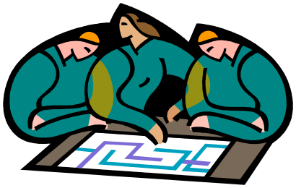
a cryptic quiz idea
It encourages them to use dictionaries and they have to find the names of the pop groups.
In small teams I give them a sheet with some 'cryptic' clues on and they have to work out the name of the artist or group
e.g. 'falaise riche dur' would be 'cliff rich hard' = Cliff Richard!
I have used it with Years 7 + 8 and they loved it enough to go and design their own questions.
Devilchild

Slide 26

jumble
On one side write a list of phrases with a word missing at the end...
On the other side jumble up the missing last words and they have to pick a random number to complete the sentence.
For example
*I went to the shop today to buy a... // Mum
*I love the meals that are cooked by my... // Donkey
*When I go to the beach, I always ride the... // Potato
You get some crazy sentences, and it tends to be a good laugh!
In the case, you would say for example... "I went the shop today to buy... A"
And then you reveal and the sentence would be that they went to buy a mum.
Good for vocab practice when you have to teach a group of words in an interesting way, either as a starter or as a summary at the end.
JasonZe

Slide 27

Musn't pause/hesitate game.
Let's say the class has learnt colours today.
Get all the class stood up & have an object to point with such as a ruler.
Go round the room pointing at students, when you point at them they have to say a colour in the TL, which has not already been said in that round & there must be no 'errrms or errrrrs'.
A round lasts until a person is out & when out, they sit down & then all vocab can be used again during the next round.
The winner is the last one standing.
amibothered

Slide 28

"pass the bomb"
There's a board game called "pass the bomb" available in 'all good toy shops!'
If you take the bomb from it to time and come up with a list of subjects you've been doing e.g. le weekend dernier/le weekend prochain/le sport/mes passetemps... each person has to say a sentence about the topic and then pass the bomb to the next person.
When the bomb goes off you change topics (you can also eliminate a person, but then have to keep those "out" interested).
I have used this just timing or using an egg timer, but they prefer passing round a bomb and the time varies each round, which adds a sense of urgency
freddyrocks

Slide 29
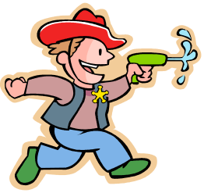
'bang!'
A good plenary that works in any subject is a game called 'bang!‘
Two pupils stand back to back, holding their hands like a gun.
The teacher says a phrase or word either in the TL or in English
The first pupil to turn around, give the correct answer or translate the phrase, then say 'bang!' wins!
jen2049

Slide 30

"Round the World."
Using flashcards of the target vocab, the first child stands behind the second.
You then quickly show them the flashcard and the first to say the correct word moves behind the third child, whoever lost sits (or remains sitting) in the second child's seat.
The object of the game is to get all the way round the class and back to your seat first.
yanaliestevens

Slide 31


'What's the time Mr Wolf'
I used to play 'What's the time Mr Wolf' in French and German as an outdoor game with my pupils. Great for practising the time....obviously!
JennyD

Slide 32

Ten steps game
The students stand outside, however they feel comfortable. Each one has ten steps which they can use in order to get close to the people they like.
Everbody starts walking in the same moment: 2 steps at first. Then there is a moment, when they can look around to see, where the others have moved to. After that the take 5 steps and then finish off with 3 steps.
In the end everybody stands close to others they like and now can say something nice:
"du bist sehr freundlich", "ich finde dich sehr nett", "du siehst sehr gut aus" etc.
Note: the class should know each other quite well and there should be generally a good atmosphere in the group. You might want to address the issue of outsiders and respect beforehand or after the lesson.
candida at
Notes:
It is sometimes quite touching, how lovely they talk to each other and you will have some students leaving the lesson with a little halo ;-)

Slide 33

housemove
We had a student leaving our y7 group due to housemove. I planned some activities about describing people and the I gave a coloured card to each student. They were asked to write a short card to this student following the model:
Lieber Ben,
du bist sehr freundlich und sehr sportlich. Dein Lieblingsfach ist Mathe und du bist auch ziemlich gut in Deutsch. Ich finde dich sehr kreativ und total lustig.
Ich werde dich vermissen.
Deine Charlotte
During that time the student (Ben) was asked to write a short letter to his form tutor in German, which we passed on together.
Ben's letters were read in the lesson and then packed and sealed in an envelope for him to take with him.
candida at

Slide 34

'pass the parcel'
Basically have a box/envelope that can be passed around the room to music.
When the music stops the pupils holding the box must pic out at card (it could have a pic/sentence to order/question etc) and say whatever goes with the card in the target language.
This works particularly well with the Mission Impossible theme tune. If you have a large class you can add in more boxes or have groups with their own boxes.
tgroskop

Slide 35

'hot seating'
A pupil comes and sits at the front of the class.
You are going to ask them 10 things (ques, vocab, pic to identify etc).
The rest of the class write down the no's 1 - 10.
You tell the pupil in the 'hot seat' that they must make some mistakes (takes the pressure off).
As he/she answers the questions the rest of the class make a note of whether the answers are correct or not (teacher needs to do this too!)
When finished the class can discuss the results. If you feel like it you could take in a hat for the pupil at the front to wear or I noticed Tesco's are selling huge foam microphones which could be fun!
tgroskop

Slide 36

'memory' / 'pairs'
Pupils have cards with pictures on and other cards with words/phrases on.
Turn all the cards over so the pics/words can't be seen and take it in turn to turn over 2.
If you find a matching pair, pick it up. Winner has most cards at end.
tgroskop

Slide 37

Strip bingo
Give each student a strip of paper and ask them to fold it into 5, then unfold.
On each of the 5 squares write a number between 1-10
Teacher calls out a question in French: ‘20 divisé par 5’
If a student has the answer at either end of his paper strip, he can tear it off. If the answer is in the middle somewhere he can’t and will have to wait to see if it comes up again sometime
Winner is first student to have discarded all his numbers – get him to read them back to the class though!
Great for making them listen to the same words more than once! It can be adapted for colours and all sorts of vocabulary.
Louise P

Slide 38

Deaf Chinese Whispers
Divide class into 2 or more groups
One person from each group comes to teacher who whispers a word
They play deaf and ask for repetition until they feel they know the word really well
Then they go tell the next person in their group, who plays deaf and asks for repetition etc..
Winners are not just the first group to finish but also can demonstrate that they ALL know the word brilliantly.
Louise P
Notes:
Thanks to Louise Pagden for this one

